Slide 1
CST 205 Final
Tai Nguyen, Matthew Lisec, & Yong Jiang

Slide 2
Objective
Use the python programming language to create a text based game that manipulates images as the user advances.

Slide 3
Approach
We created a text based game much like one of our previous labs that has the user input letters to guess what the word is. Once a word is input into the program, the program generates white boxes over an image that correlates with how many letters are in the word. Each correct guess will fill in one of the white boxes.
Matthew
Create base program
Yong
Format images
Tai
Edit program and images to work together

Slide 4
Results
Matthew
Finished base program using lists
Yong
Arranged pictures in proper pixel locations
Tai
Edited program to use dictionaries to hold pixel values
Added image manipulation functions into the program
Input image values to be called in the program

Slide 5
Demonstration of Program

Slide 6
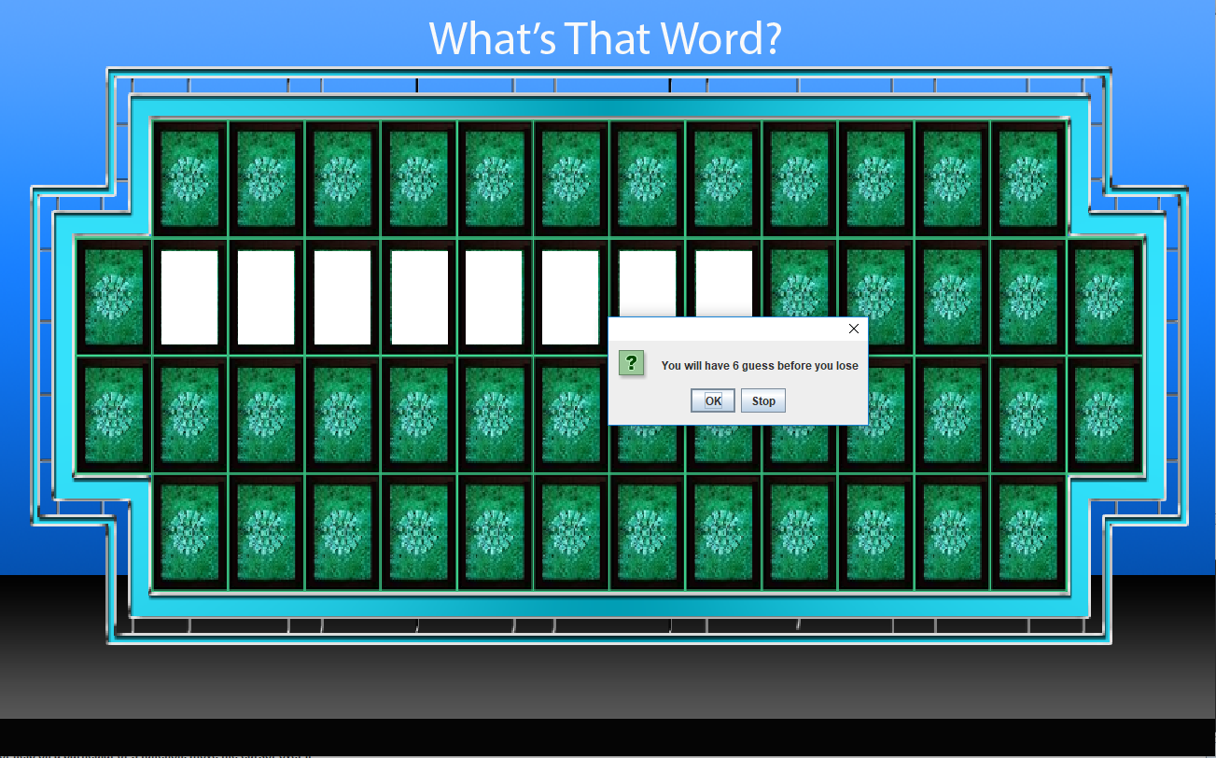
Program Startup

Slide 7

Guessing a letter

Slide 8
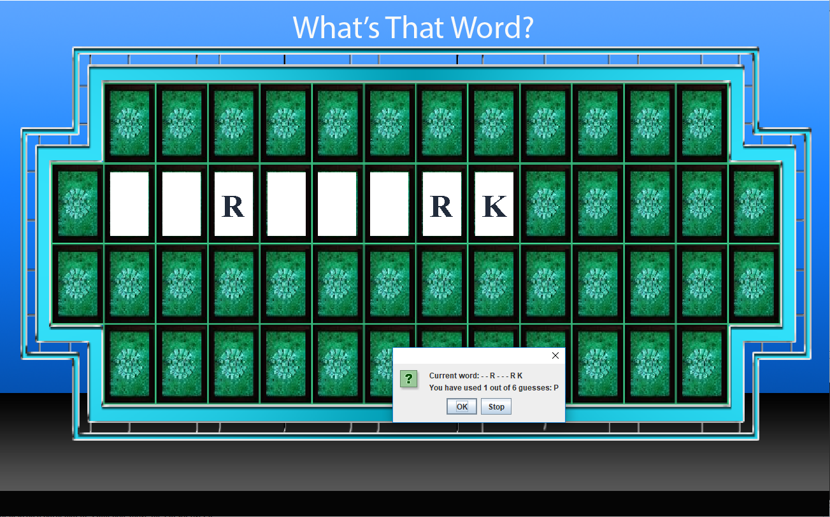
After a few guesses

Slide 9
What we learned...

Slide 10
Tai Nguyen
Collaborating with group members to achieve a common goal and designating appropriate tasks based on skill and comfort level
Manipulating image files by iterating through each individual pixel
Creating HTML files by inputting our own values or sorting through an existing HTML file to pull the information and input it into another HTML file

Slide 11
Matthew Lisec
Manipulating strings by use of lists and dictionaries in order to obtain a desirable outcome
Manipulating sound files by iterating through a sound file
Creating classes in order to create my own objects and continue to develop more complex programs

Slide 12
Yong Jiang
Manipulating images by comparing values of pixels and replacing them as needed
Using lists and dictionaries to organize data in a way that the entire program can access
Debugging practices by methodically going through programs and adding in blocks of code to isolate issues

Slide 13
Link to Doc
Thank You

